Slide 1
IoT based integrated smart home protocol for wellness sensing and assistive living
THE TEAM MEMBERS
Zhenwei FU
Zhenpeng Wang
Keke Shi
Lin Chen
Wang Zhan
Yan Chen

Slide 2
This presentation
Aims and Objectives
System Overview
Plan and Schedule
Introducing various sensing modules
Computer and Cloud interface
Challenges faced
Future prospects

Slide 3
Aims and Objectives
Targets rehabilitation and elders care.
Health care and life care of elderly to enhance life span.
Ambient and comfortable environment.
An overview of the system
Integrated sensors via Internet of Things (IoT).
9 different kind of sensors.
Microcontroller ESP 32 with wireless data transfer via Wi-Fi.

Slide 4
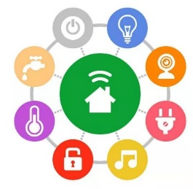
Activities of daily living
Air conditioner
Bed Room
Get up in night
Wake up
Using Toilet
Going bed
Hygiene
Juicer
Shower
Microwave oven
Kitchen
Bath Room
Dish Washer
Going Out
Toaster
Entry/Exit
Return
Water Kettle
Dining Chair
Electric Stove

Slide 5
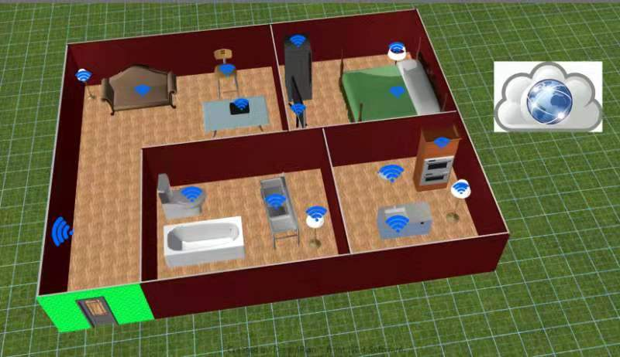
3D graph

Slide 6

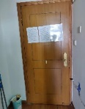
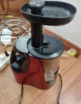
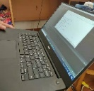
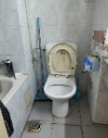
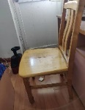
System Overview
Heterogeneous Sensing system
Network Administrator
DECISION MAKING MODULE
Gateway
Activity Annotation
Activity Detection
Behavioural Pattern Generation

Slide 7
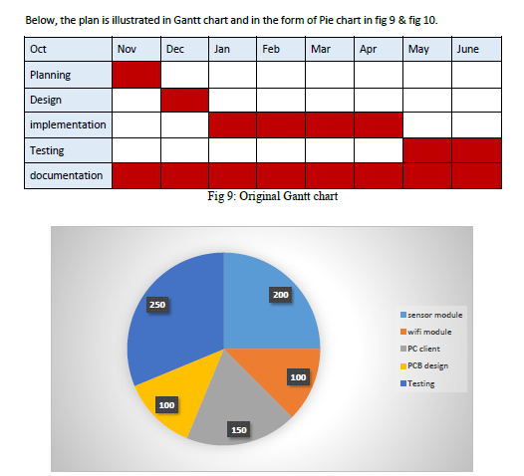
Plan and Schedule
Fig: Gantt and Pie chart of planning and scheduling work.

Slide 8
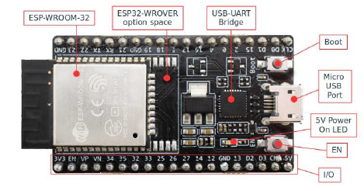
Implementation
Microcontroller
ESP 32 is used
Small size
Wireless functionality and analog inputs.
High quality and affordable than its peers.
Wi-Fi and Bluetooth.
Temp. range -40 to 125C.
Suitable for IoT applications.
Fine grained clock gating, dynamic power scaling.
Fig: ESP 32 Microcontroller.

Slide 9
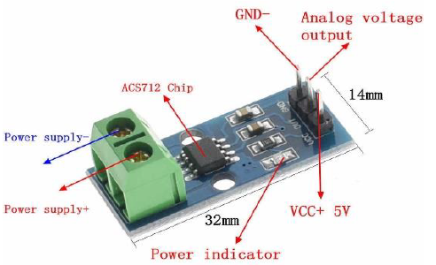

Implementation
Current Sensor
30 Ampere ACS-712.
Software Module:
C and Python
Application:
AC, Laptop and Juicer.
Fig: ACS 712 connected with the Juicer.

Slide 10
Implementation
Current Sensor
Fig: PCB design in Altium designer of 4 Current sensors connected with MC.

Slide 11


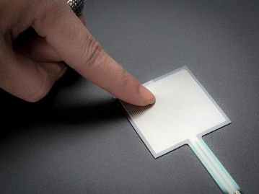
Implementation
Touch Sensor
Designed using TTP223 BA6 IC, 1000 ohm resistor and 100nF capacitor.
Indigenously built.
Toggles between 0 and 1 state.
Very sensitive and efficient.
Application:
Chair, Bed, Toilet.
Fig: Touch sensor application and PCB.

Slide 12
Implementation
Temperature Sensor
LM35 sensor.
Calibrated directly in Celsius.
Less current drain and low self heating.
Application:
Room
Fig: Circuit diagram of LM 35.

Slide 13
Implementation
Motion Sensor
Two Grove PIR sensors used in AND gate configuration.
Works within 90 degree angle.
Detects within 5m.
Operates within 3V to 5V.
Application:
Room
Sensor 1
Sensor 2
Fig: Two Grove PIR sensors at door entrance.

Slide 14
Interface
Computer Interface
Python is used.
Integrated Development Environment (IDE) Pycharm.
Fig: Chair and Juicer output.

Slide 15
Interface
Computer Interface
Python is used.
Integrated Development Environment (IDE) Pycharm.
Fig: Output from Bed

Slide 16
Interface
Computer Interface
Fig: Combine output of the sensors.

Slide 17
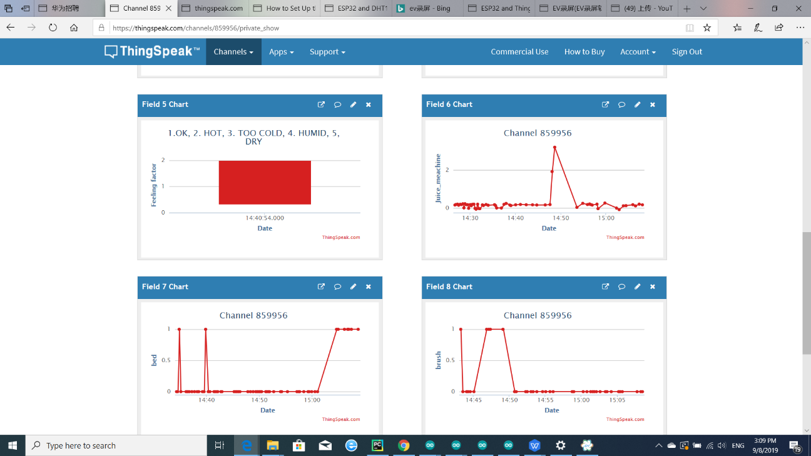
Interface
Cloud interface
Graphs generated using Thingspeak.com.
Data is transferred in real time.
Fig: Graphs of various modules generated online.

Slide 18
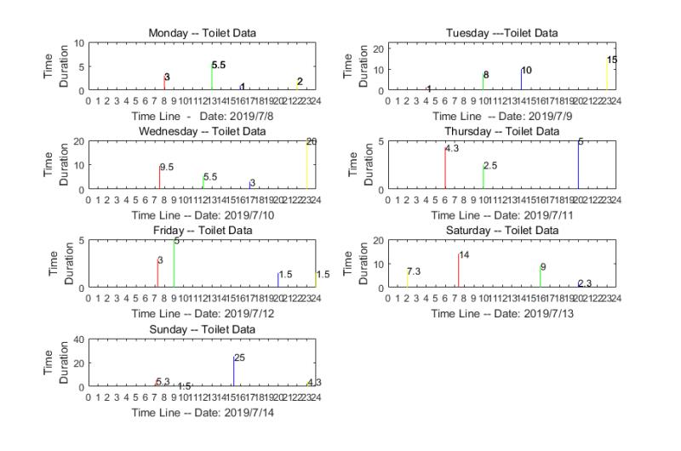
Interface
Cloud interface
2nd Instant.
Fig: Graphs of various modules generated online.

Slide 19
Challenges Faced
Diverse hardware and software affecting the process of integration.
Processing time gets to be distinctly pivotal.
Tremendous time consumption in finding appropriate sensors.
Sensor malfunctioning and inaccurate data transfer with delay.

Slide 20
Future Prospects
For user friendly experience, a mobile app can be developed.
More sophisticated, commercial and aesthetically sound packaging.
Subject to monitory resources and availability of time, supplementary layer of AI can be inserted.

Slide 21


